Slide 1


Highly Accurate Protein Structure Prediction
with AlphaFold
Artificial Intelligence 前沿论文解读
报告人：陈星强
更多人工智能的信息请关注官网：www.deepomics.ltd

Slide 2
论文作者信息
Affiliations
DeepMind, London, UK John Jumper, Richard Evans, Alexander Pritzel, Tim Green,
Seoul National University, Seoul, South Korea Martin Steinegger
Correspondence to John Jumper or Demis Hassabis.
Subjects
Computational biophysics
Machine learning
Protein structure predictions
Structural biology
更多人工智能的信息请关注官网：www.deepomics.ltd

Slide 3
Abstract
摘要部分
更多人工智能的信息请关注官网：www.deepomics.ltd

Slide 4
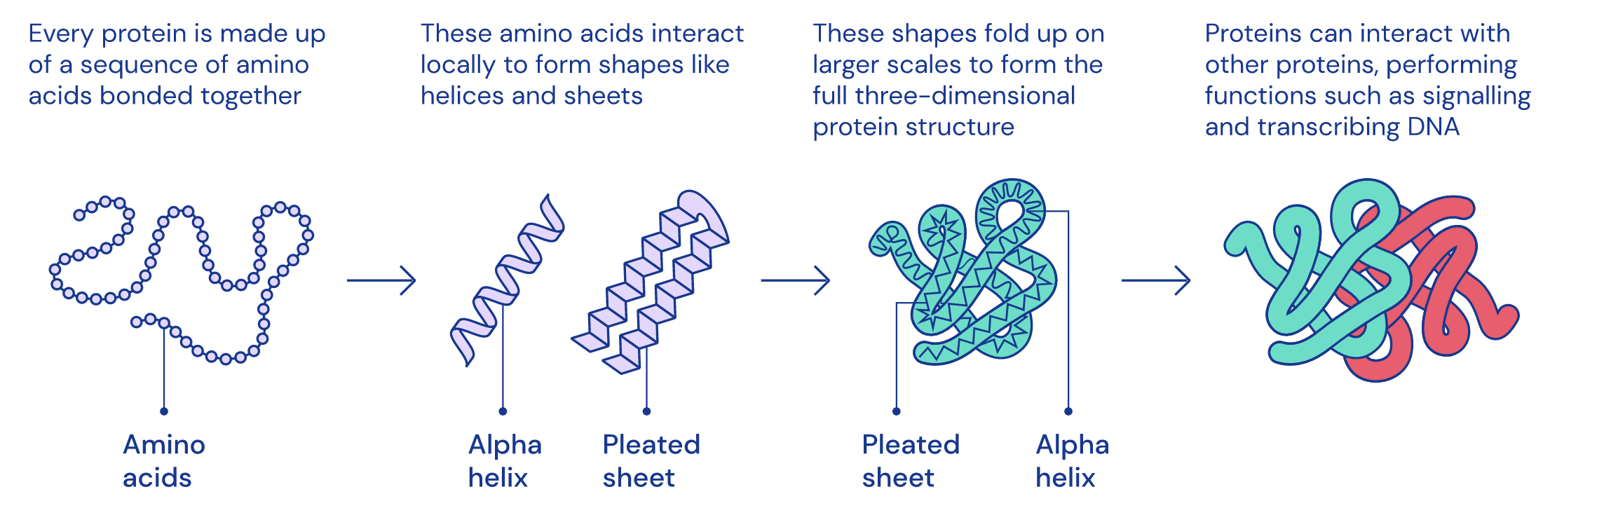
Abstract
更多人工智能的信息请关注官网：www.deepomics.ltd

Slide 5
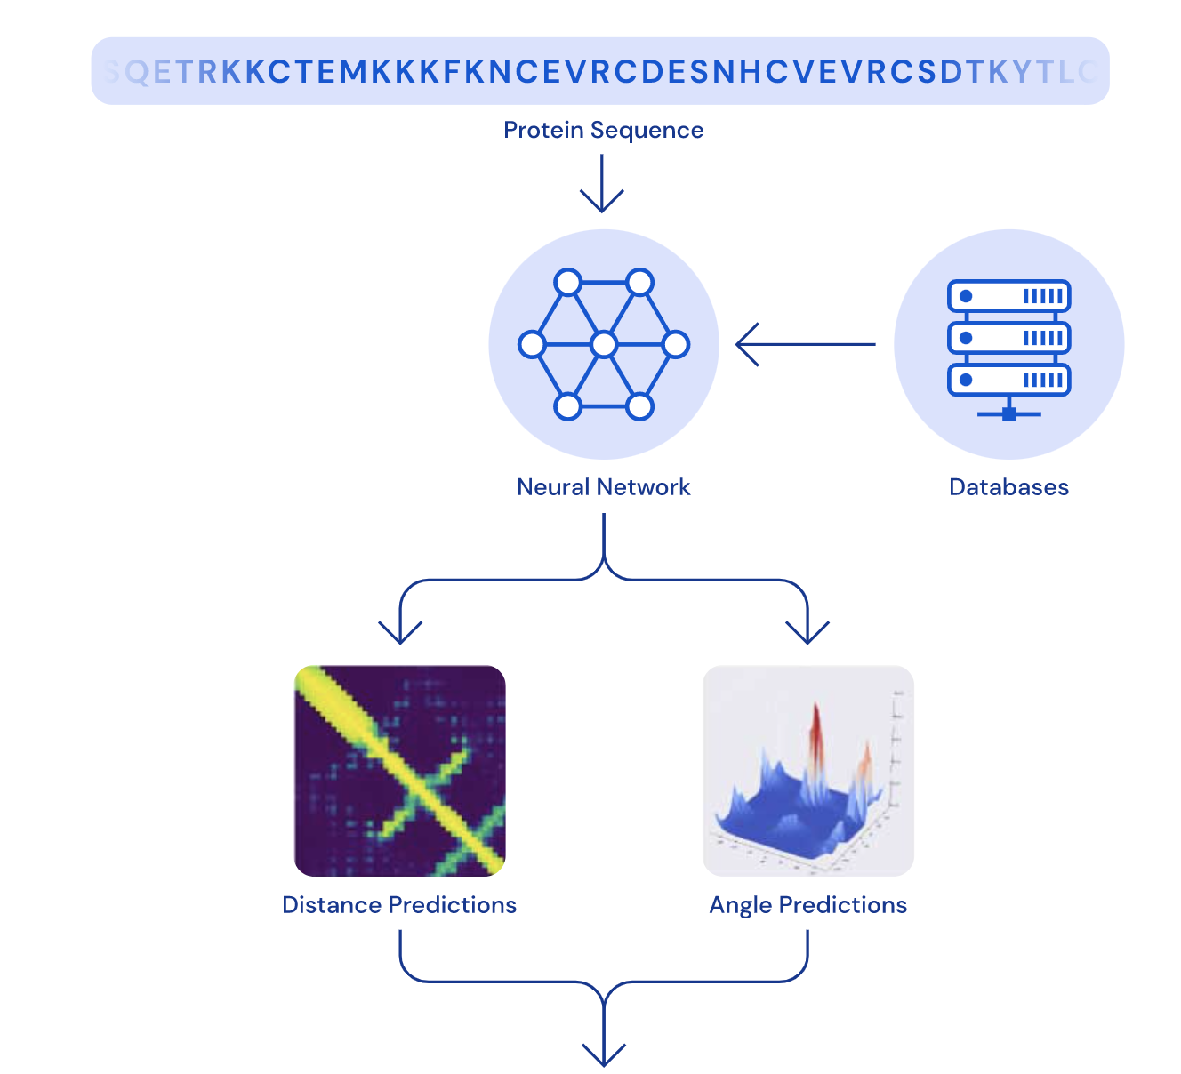
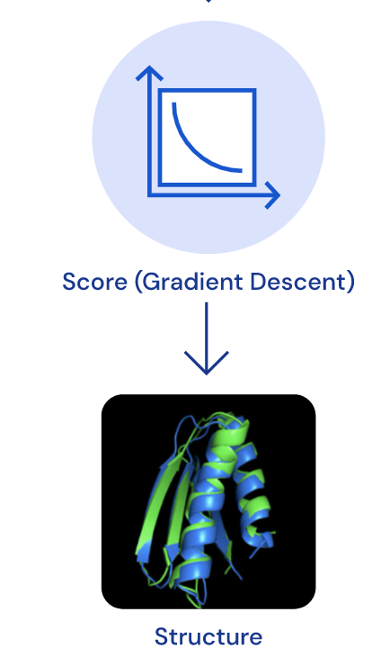
Abstract
A schematic of the architecture of the AlphaFold system predicting structure from protein sequence.
更多人工智能的信息请关注官网：www.deepomics.ltd

Slide 6
基础概念学习
Notation
更多人工智能的信息请关注官网：www.deepomics.ltd

Slide 7
基础概念学习
1. Amino acid
2. Pipetide bond
3. Chi Angle
3. lDDT-Cα
4. template modeling score (TM-score)
5. multiple sequence alignments (MSAs)
6. pairwise features
7. homologues
8. IPA
9.Evoformer
10. pLDDT per-residue accuracy of the structure
11. TM-score pTM
12. Pair-wise error prediction
13. Frame-aligned point error FAPE
更多人工智能的信息请关注官网：www.deepomics.ltd

Slide 8
2. 肽键
https://en.wikipedia.org/wiki/Amino_acid
更多人工智能的信息请关注官网：www.deepomics.ltd

Slide 9
基础信息 概念解释 肽键
https://en.wikipedia.org/wiki/Peptide_bond
更多人工智能的信息请关注官网：www.deepomics.ltd

Slide 10
基础信息 概念解释 肽键
https://en.wikipedia.org/wiki/Amino_acid https://en.wikipedia.org/wiki/Peptide_bond
更多人工智能的信息请关注官网：www.deepomics.ltd

Slide 11
1. 氨基酸
https://en.wikipedia.org/wiki/Amino_acid
更多人工智能的信息请关注官网：www.deepomics.ltd

Slide 12
基础信息 概念解释 氨基酸
https://en.wikipedia.org/wiki/Amino_acid
更多人工智能的信息请关注官网：www.deepomics.ltd

Slide 13
基础信息 概念解释 氨基酸
https://en.wikipedia.org/wiki/Amino_acid
更多人工智能的信息请关注官网：www.deepomics.ltd

Slide 14
3. Chi Angle
Dihedral angles in glutamate
http://www.biomedcentral.com/1471-2105/11/306
https://swissmodel.expasy.org/course/text/chapter3.htm
http://www.mlb.co.jp/linux/science/garlic/doc/commands/dihedrals.html
http://www.mlb.co.jp/linux/science/garlic/doc/commands/dihedrals.html
更多人工智能的信息请关注官网：www.deepomics.ltd

Slide 15
3. Chi Angle
The angle between two bonds
The backbone of a protein has three different torsion angles.
The phi-angle (φ) - around the N-Cα bond
The psi-angle (ψ) - around the Cα-C bond
The omega-angle (ω) - around the peptide bond between C and N.
更多人工智能的信息请关注官网：www.deepomics.ltd

Slide 16
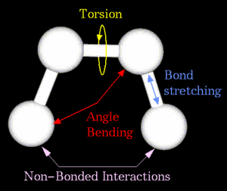
3. Chi Angle
The ω-bond has a slightly double-bond character and is therefore almost always 180 degrees.
The structure of a protein is mainly formed by the φ- and ψ-angles.
Every secondary structure element forces the backbone into a specific range of torsion angles, this can be visualized in a ramachandran plot.
The figure shows the location of the φ, ψ and ω-angles.
Side chains can also contain torsion angles, they are indicated as chi-angles.
更多人工智能的信息请关注官网：www.deepomics.ltd

Slide 17
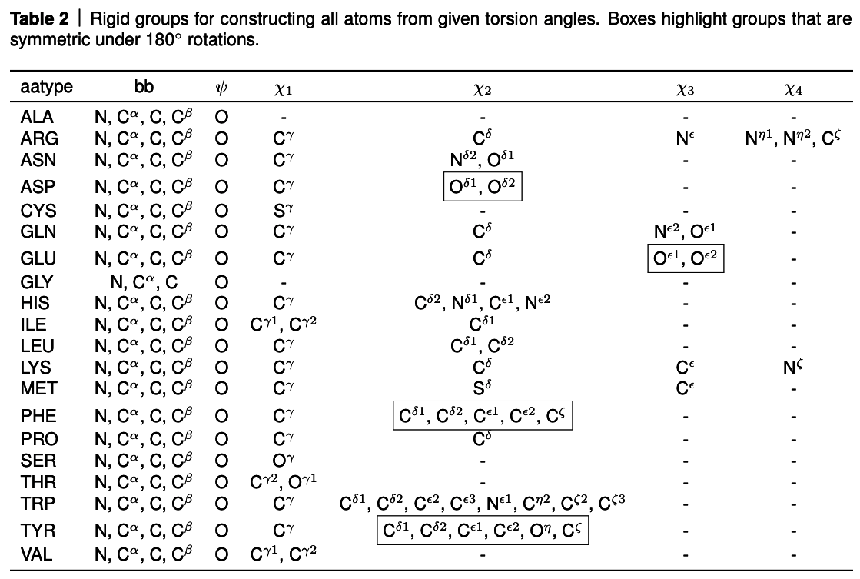
3. Chi Angle
更多人工智能的信息请关注官网：www.deepomics.ltd

Slide 18
基础概念学习
N_{res：}the number of residues in the input primary sequence (cropped during training).
N_{templ：}the number of templates used in the model.
N_{all_seq：}the number of all available MSA sequences.
N_{clust：} the number of clusters after MSA clustering.
N_{seq：} the number of sequences processed in the MSA stack (where N_{seq} = N_{clust} + N_{templ}).
N_{extra_seq：}the number of unclustered MSA sequences (after sub-sampling).
N_{block：}the number of blocks in Evoformer-like stacks.
N_{ensemble：} the number of ensembling iterations.
N_{cycle：}the number of recycling iterations.
更多人工智能的信息请关注官网：www.deepomics.ltd

Slide 19
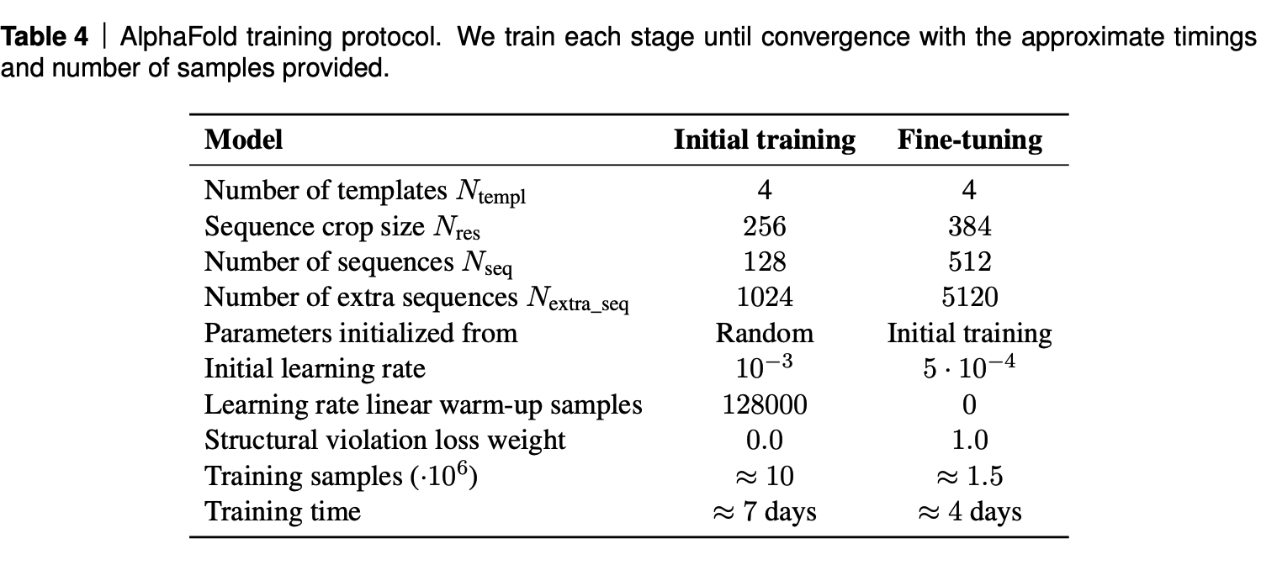
基础概念学习
更多人工智能的信息请关注官网：www.deepomics.ltd

Slide 20
算法列表
List of Algorithms
更多人工智能的信息请关注官网：www.deepomics.ltd

Slide 21
List of Algorithms
 | Function Name | Instruction
1 | MSABlockDeletion | MSA block deletion
2 | Inference | AlphaFold Model Inference
3 | InputEmbedder | Embeddings for initial representations
4 | relpos | Relative position encoding
5 | one_hot | One-hot encoding with nearest bin
6 | EvoformerStack | Evoformer stack
7 | MSARowAttentionWithPairBias | MSA row-wise gated self-attention with pair bias
8 | MSAColumnAttention | MSA column-wise gated self-attention
9 | MSATransition | Transition layer in the MSA stack
10 | OuterProductMean | Outer product mean
11 | TriangleMultiplicationOutgoing | Triangular multiplicative update using “outgoing” edges
12 | TriangleMultiplicationIncoming | Triangular multiplicative update using “incoming” edges
13 | TriangleAttentionStartingNode | Triangular gated self-attention around starting node
14 | TriangleAttentionEndingNode | Triangular gated self-attention around ending node
15 | PairTransition | Transition layer in the pair stack
更多人工智能的信息请关注官网：www.deepomics.ltd

Slide 22
AlphaFold Model Inference
List of Algorithms
 | Function Name | Instruction
16 | TemplatePairStack | Template pair stack
17 | TemplatePointwiseAttention | Template pointwise attention
18 | ExtraMsaStack | Extra MSA stack
19 | MSAColumnGlobalAttention | MSA global column-wise gated self-attention
20 | StructureModule | Structure module
21 | rigidFrom3Points | Rigid from 3 points using the Gram–Schmidt process
22 | InvariantPointAttention | Invariant point attention(IPA)
23 | BackboneUpdate | Backbone update
24 | computeAllAtomCoordinates | Compute all atom coordinates
25 | makeRotX | Make a transformation that rotates around the x-axis
26 | renameSymmetricGroundTruthAtoms | Rename symmetric ground truth atoms
27 | torsionAngleLoss | Side chain and backbone torsion angle loss
28 | computeFAPE | Compute the Frame aligned point error
29 | predictPerResidueLDDT | Predict model confidence pLDDT
30 | RecyclingInference | Generic recycling inference procedure
31 | RecyclingTraining | Generic recycling training procedure
32 | RecyclingEmbedder | Embedding of Evoformer and Structure module outputs for recycling
更多人工智能的信息请关注官网：www.deepomics.ltd

Slide 23
论文背景介绍
Introduction
更多人工智能的信息请关注官网：www.deepomics.ltd

Slide 24
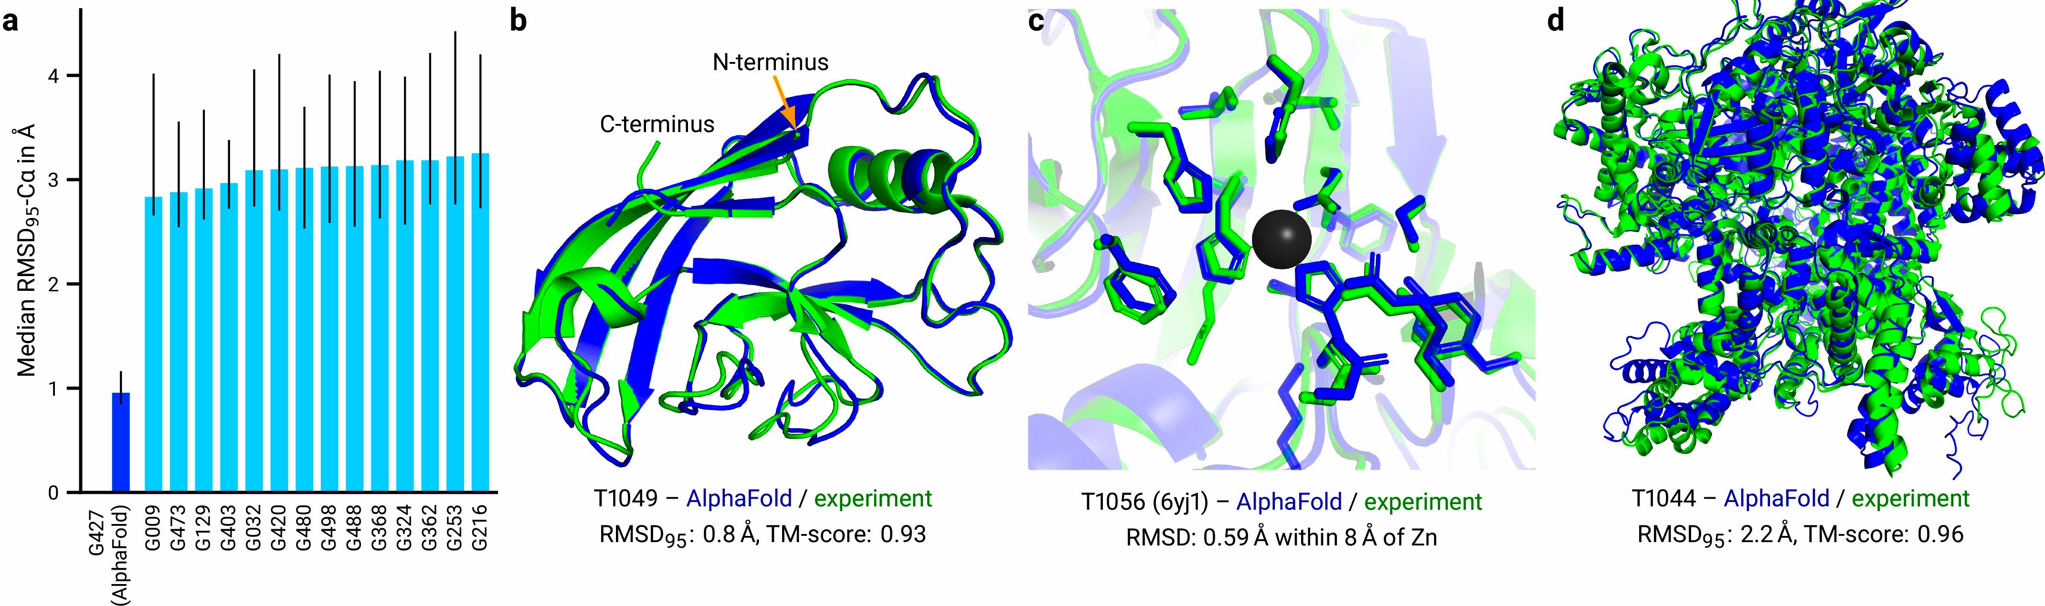
基础信息 模型效果
更多人工智能的信息请关注官网：www.deepomics.ltd

Slide 25
论文方法介绍
AlphaFlod network
更多人工智能的信息请关注官网：www.deepomics.ltd

Slide 26
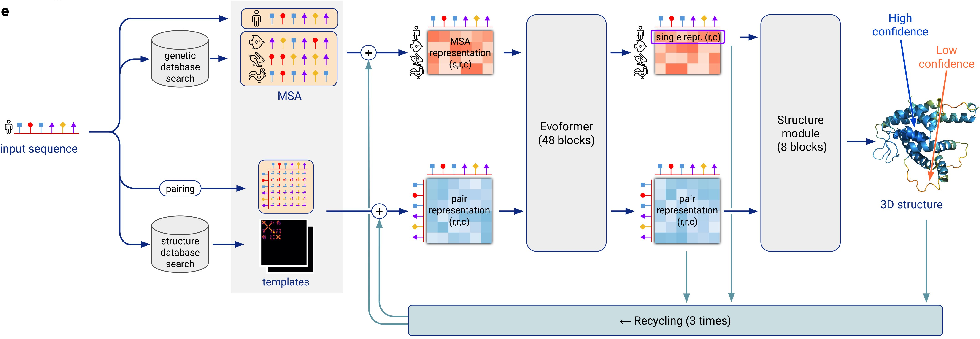
基础信息 模型框架
更多人工智能的信息请关注官网：www.deepomics.ltd

Slide 27
核心算法模块 Evoformer
Evoformer
更多人工智能的信息请关注官网：www.deepomics.ltd

Slide 28
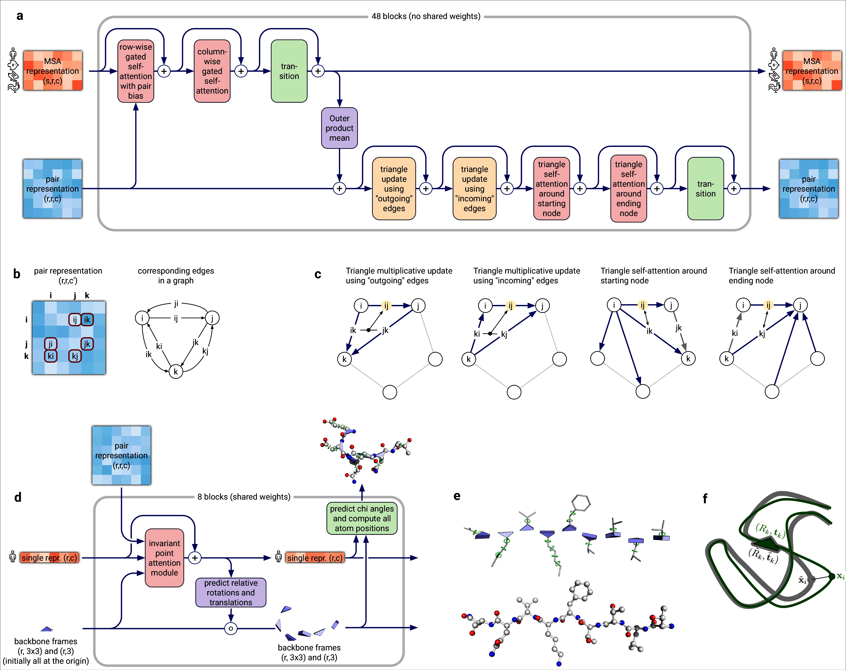
模型模块 Evoformer
更多人工智能的信息请关注官网：www.deepomics.ltd

Slide 29
模型模块 Evoformer
The pair representation interpreted as directed edges in a graph.
更多人工智能的信息请关注官网：www.deepomics.ltd

Slide 30
模型模块 Evoformer
更多人工智能的信息请关注官网：www.deepomics.ltd

Slide 31
模型模块 Evoformer
更多人工智能的信息请关注官网：www.deepomics.ltd

Slide 32
模型模块 Evoformer
更多人工智能的信息请关注官网：www.deepomics.ltd

Slide 33
核心算法框架
End-to-end structure prediction
更多人工智能的信息请关注官网：www.deepomics.ltd

Slide 34
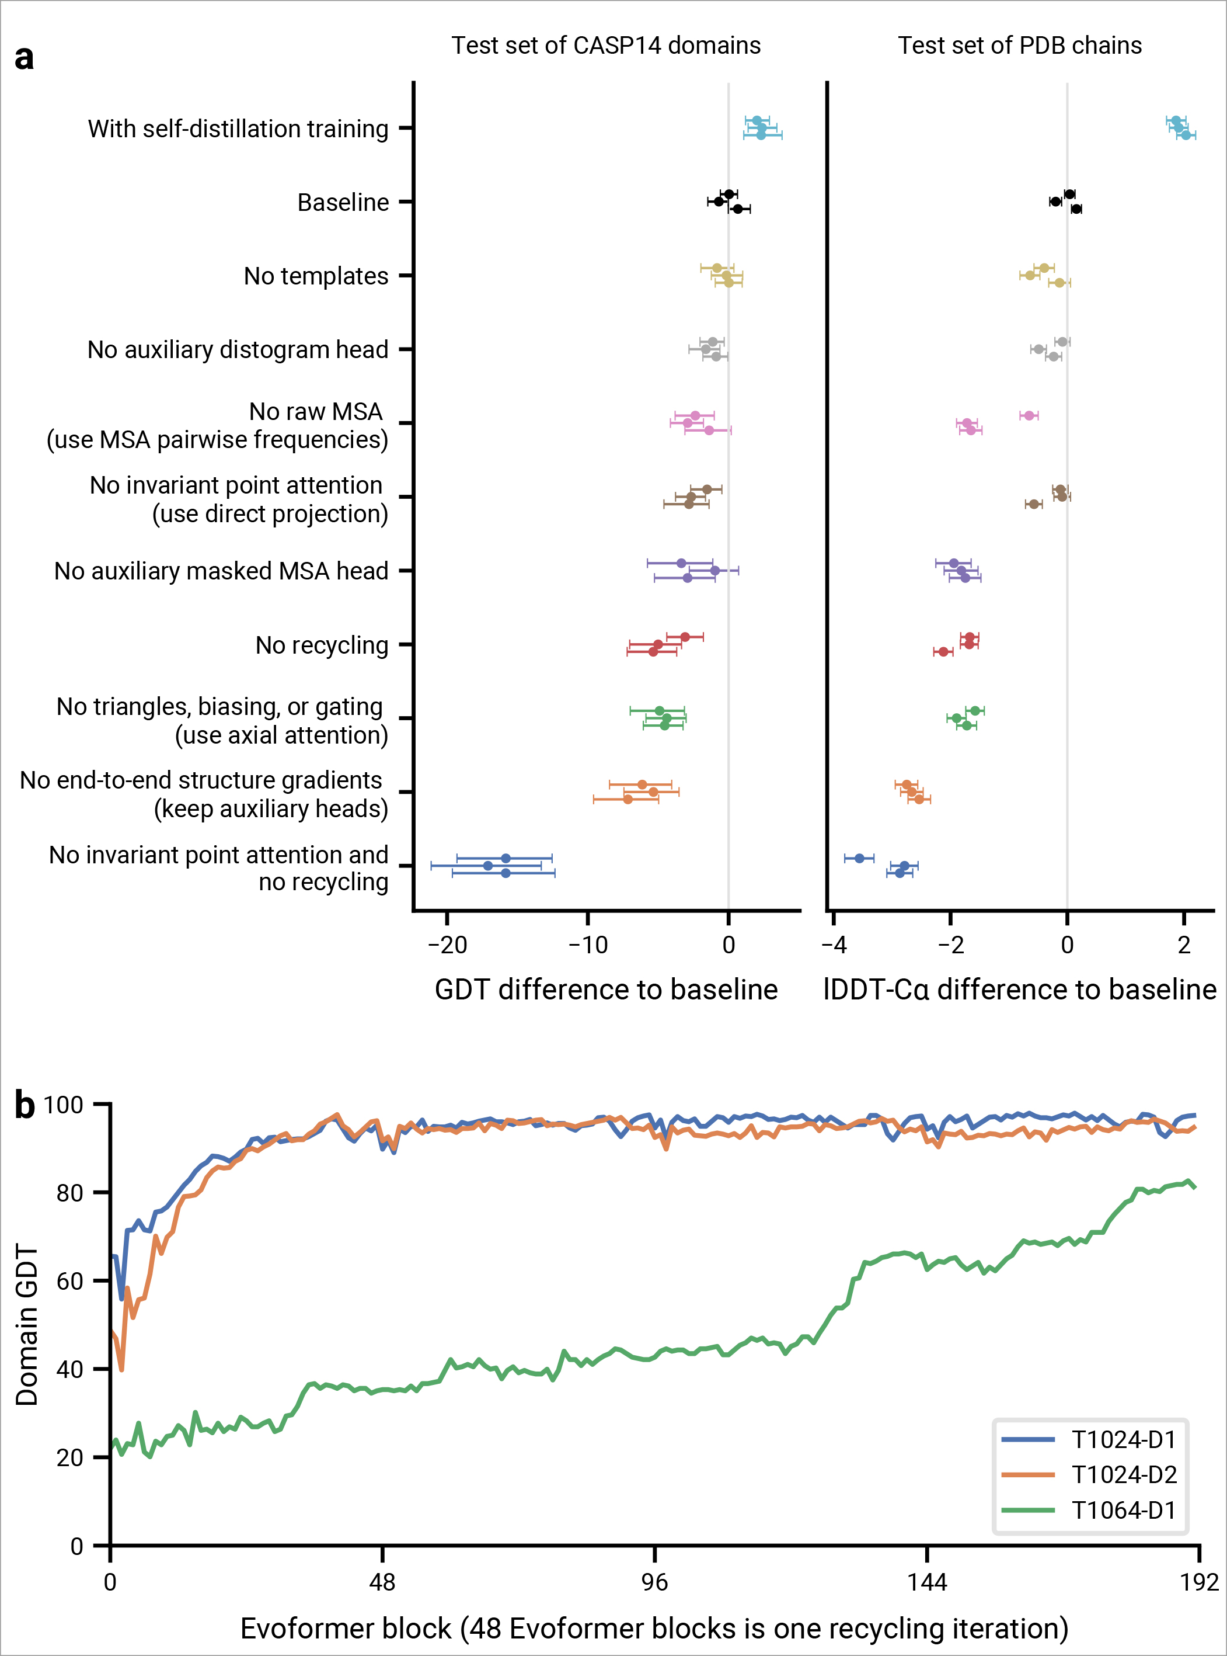
核心算法框架
更多人工智能的信息请关注官网：www.deepomics.ltd

Slide 35
核心算法框架
更多人工智能的信息请关注官网：www.deepomics.ltd

Slide 36
模型训练方法
Training with labelled and Unlabelled data
更多人工智能的信息请关注官网：www.deepomics.ltd

Slide 37
模型训练方法
Training with labelled and Unlabelled data
更多人工智能的信息请关注官网：www.deepomics.ltd

Slide 38
模型训练方法
Training with labelled and Unlabelled data
更多人工智能的信息请关注官网：www.deepomics.ltd

Slide 39
MSA 处理方法
MSA depth and cross-chain contacts
更多人工智能的信息请关注官网：www.deepomics.ltd

Slide 40
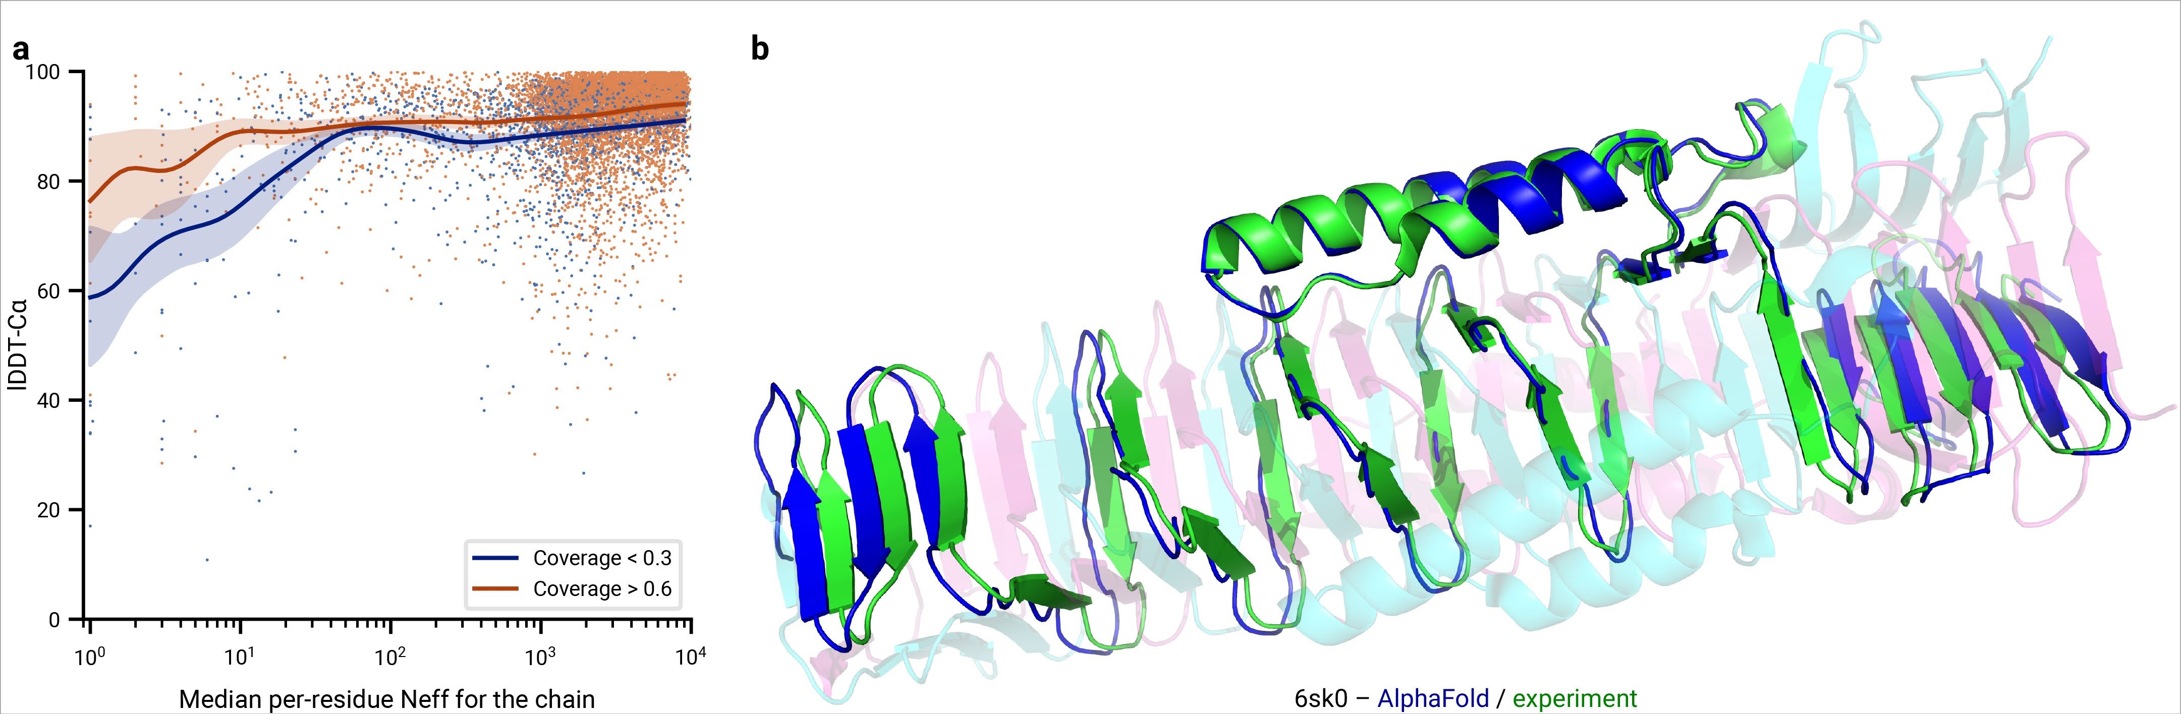
MSA 处理方法
更多人工智能的信息请关注官网：www.deepomics.ltd

Slide 41
MSA 处理方法
MSA depth and cross-chain contacts
更多人工智能的信息请关注官网：www.deepomics.ltd

Slide 42
模型效果
Model Result
更多人工智能的信息请关注官网：www.deepomics.ltd

Slide 43
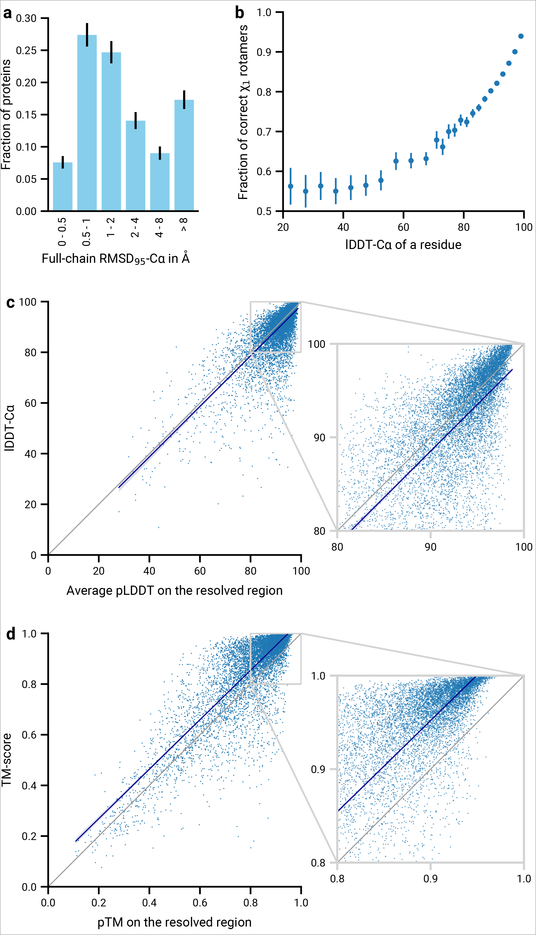
模型效果
更多人工智能的信息请关注官网：www.deepomics.ltd

Slide 44
模型效果
更多人工智能的信息请关注官网：www.deepomics.ltd

Slide 45
模型效果
更多人工智能的信息请关注官网：www.deepomics.ltd

Slide 46
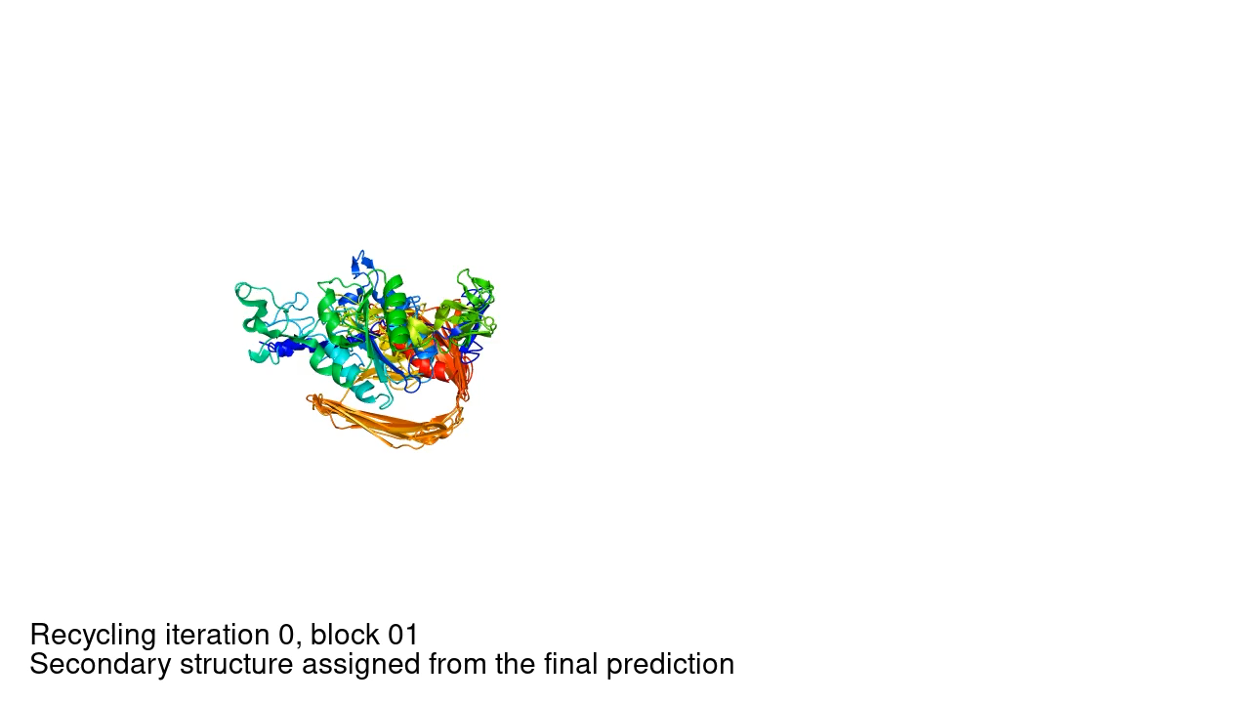
模型效果
更多人工智能的信息请关注官网：www.deepomics.ltd

Slide 47
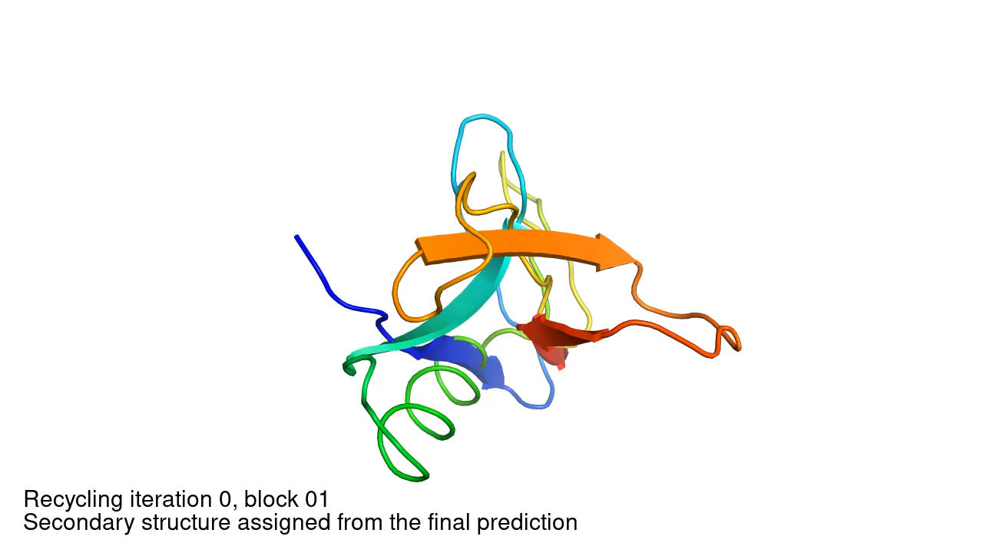
模型效果
更多人工智能的信息请关注官网：www.deepomics.ltd

Slide 48
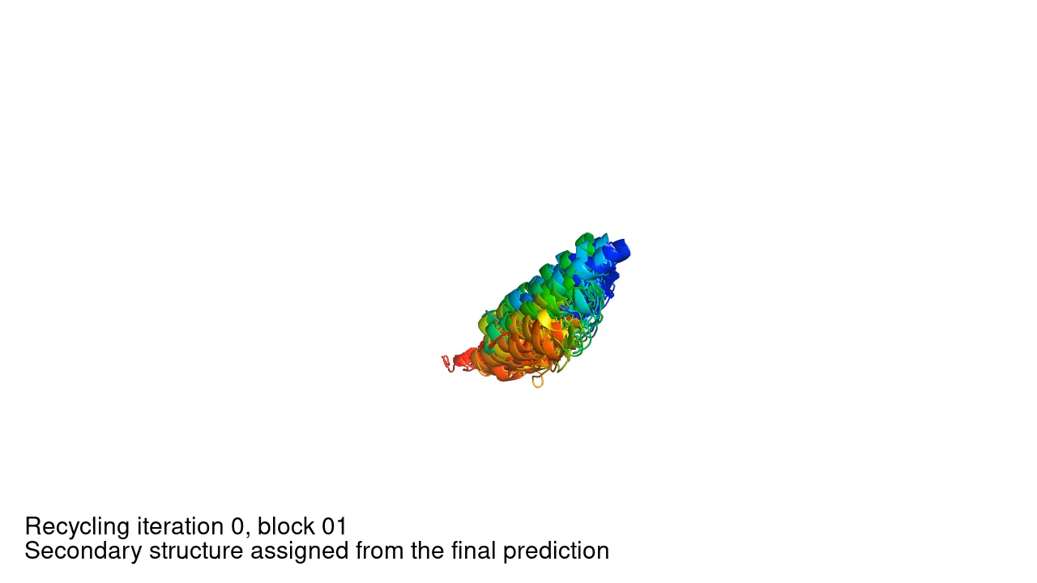
模型效果
更多人工智能的信息请关注官网：www.deepomics.ltd

Slide 49
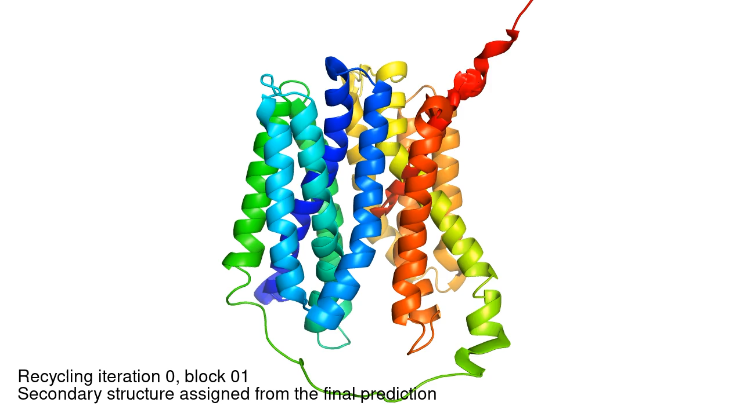
模型效果
更多人工智能的信息请关注官网：www.deepomics.ltd

Slide 50
相关工作
Related work
更多人工智能的信息请关注官网：www.deepomics.ltd

Slide 51
相关工作
https://github.com/chenxingqiang/ref-Alphafold-Code
更多人工智能的信息请关注官网：www.deepomics.ltd

Slide 52
讨论
Discusion
更多人工智能的信息请关注官网：www.deepomics.ltd

Slide 53
讨论
The methodology we have taken in designing AlphaFold is a combination of the bioinformatic and physical approaches: we use a physical and geometric inductive bias to build components that learn from PDB data with minimal imposition of handcrafted features (e.g. AlphaFold builds hydrogen bonds effectively without a hydrogen bond score function). This results in a network that learns far more efficiently from the limited data in the PDB but is able to cope with the complexity and variety of structural data.
更多人工智能的信息请关注官网：www.deepomics.ltd

Slide 54
讨论
In particular, AlphaFold is able to handle missing physical context and produce accurate models in challenging cases like intertwined homomers or proteins that only fold in the presence of an unknown heme group. The ability to handle underspecified structural conditions is essential to learning from PDB structures as the PDB represents the full range of conditions in which structures have been solved. In general, AlphaFold is trained to produce the protein structure most likely to appear as part of a PDB structure. In cases where a particular stoichiometry or ligand/ion is predictable from the sequence alone, AlphaFold is likely to produce a structure that respects those constraints implicitly
更多人工智能的信息请关注官网：www.deepomics.ltd

Slide 55
讨论
AlphaFold has already demonstrated its utility to the experimental community, both for molecular replacement , and interpreting cryogenic electron microscopy (cryo-EM) maps. Moreover, because AlphaFold outputs protein coordinates directly, AlphaFold produces predictions in graphics processing unit (GPU)-minutes to GPU-hours depending on the length of the protein sequence (e.g. around one GPU-minute per model for 384 residues, see Methods for details). This opens up the exciting possibility of predicting structures at the proteome-scale and beyond.
更多人工智能的信息请关注官网：www.deepomics.ltd

Slide 56
讨论
The explosion in available genomic sequencing techniques and data has revolutionized bioinformatics but the intrinsic challenge of experimental structure determination has prevented a similar expansion in our structural knowledge. By developing an accurate protein structure prediction algorithm, coupled with existing large and well-curated structure and sequence databases assembled by the experimental community, we hope to accelerate the advancement of structural bioinformatics that can keep pace with the genomics revolution. We hope that AlphaFold, and computational approaches that apply its techniques for other biophysical problems, will become essential tools of modern biology.
更多人工智能的信息请关注官网：www.deepomics.ltd

Slide 57
文献/资源列表
https://github.com/chenxingqiang/ref-Alphafold-Code
更多人工智能的信息请关注官网：www.deepomics.ltd

